Slide 1

Eduqas
A-Level Music
King Edward VI Handsworth Grammar School for Boys

Slide 2
Introduction
Over the next few slides you will be introduced to the Eduqas A-level course. I’ve not included all the information just the parts I feel are most relevant to you at the moment.
Please read through it carefully.
There are tasks at the end of the presentation which should be completed in time for your first lesson in September.
Mr. M. Ward
mward@Handsworth.bham.sch.uk

Slide 3
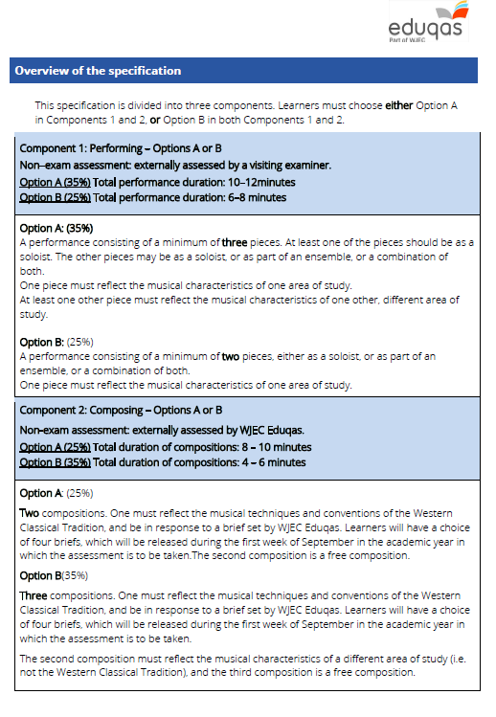
Most students opt
for ‘A’

Slide 4
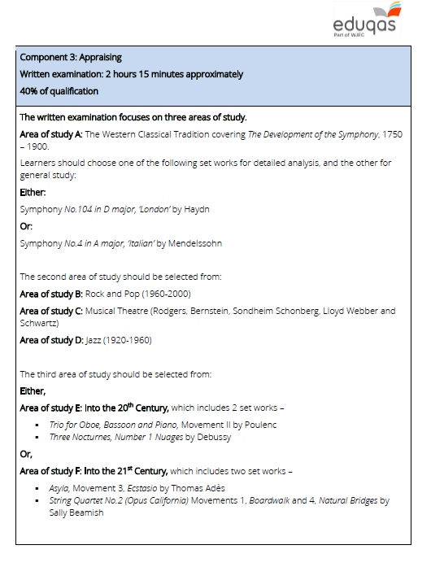
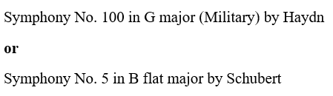

Slide 5
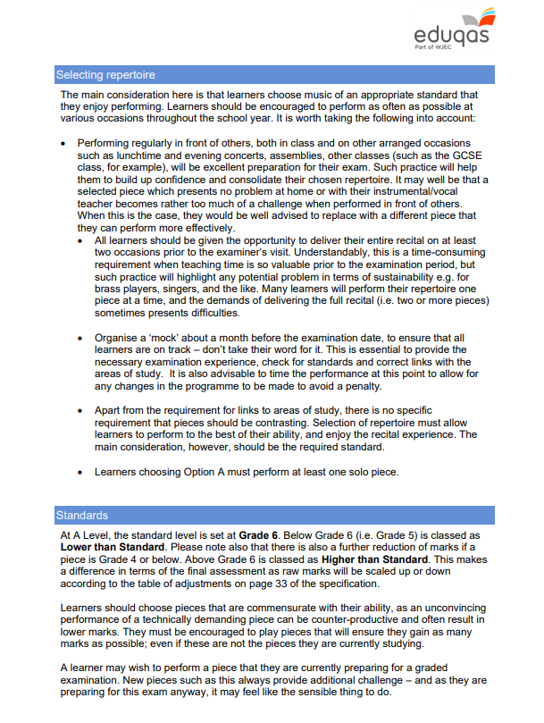
Component 1 - Performing

Slide 6
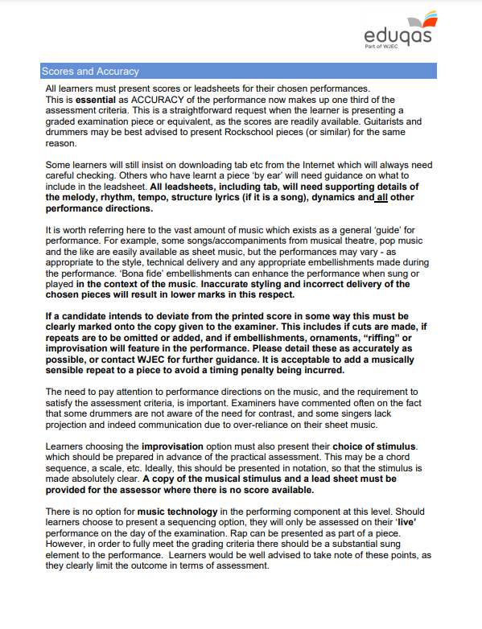
Component 1 - Performing

Slide 7
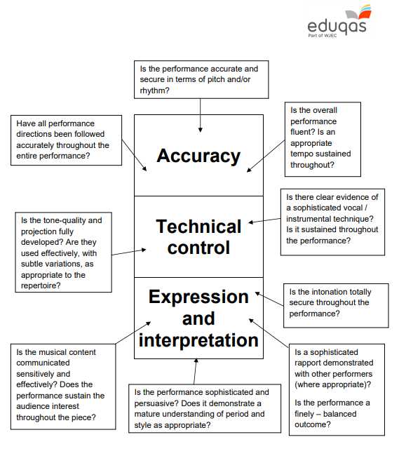
Component 1 - Performing

Slide 8
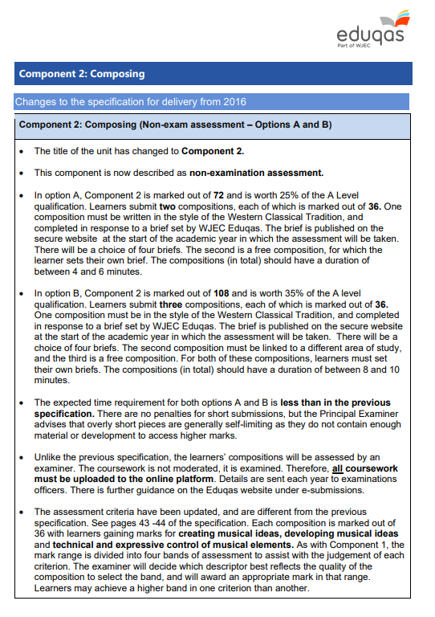
Component 2 - Composing

Slide 9
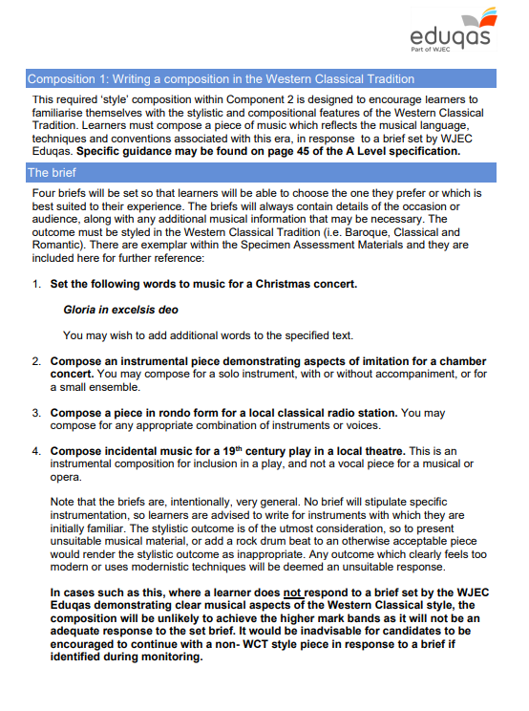
Component 2 - Composing

Slide 10
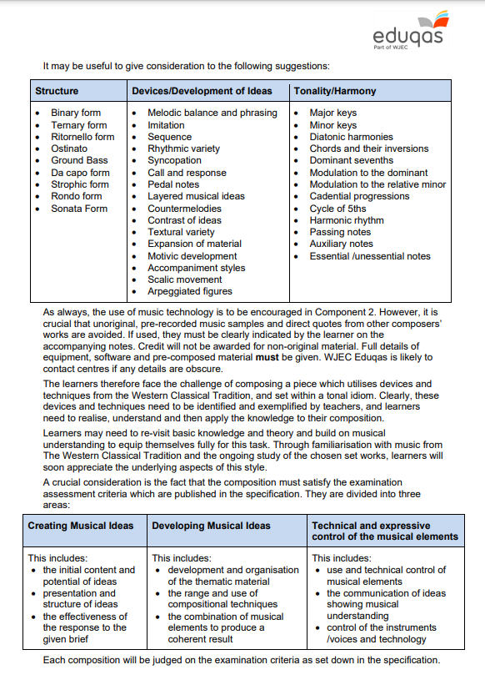
Component 2 - Composing
Make sure you know these!

Slide 11
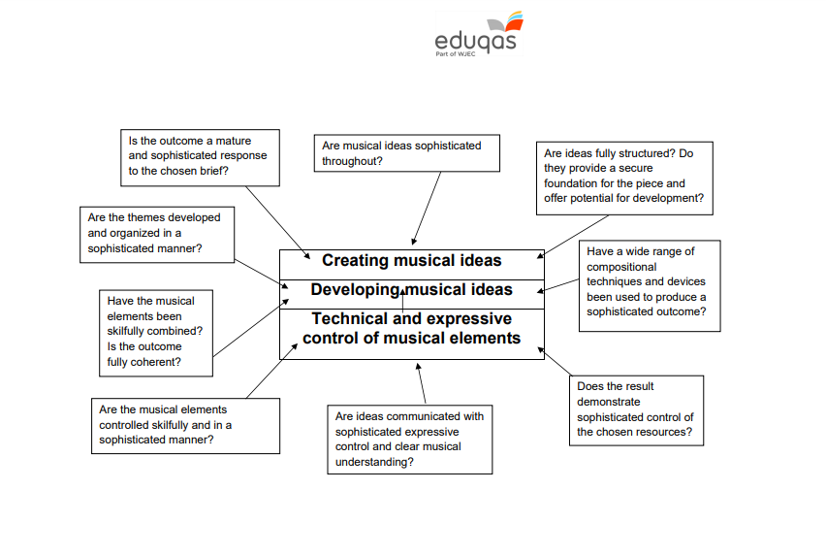
Component 2 - Composing

Slide 12
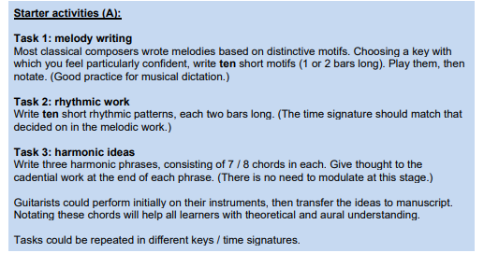
Component 2 - Composing
This is an ‘extension’ task

Slide 13

Component 2 - Composing

Slide 14
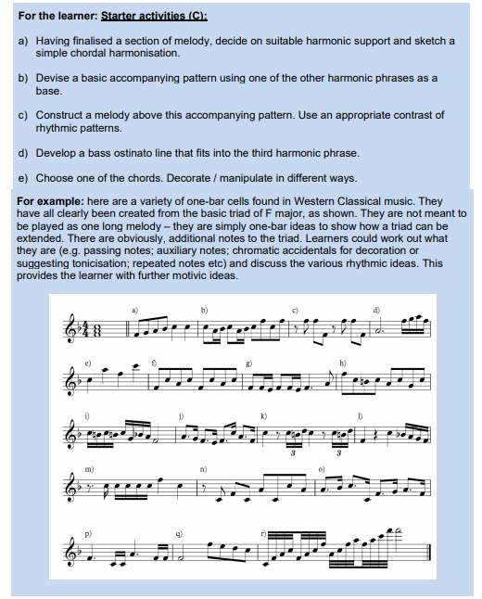
Component 2 - Composing

Slide 15
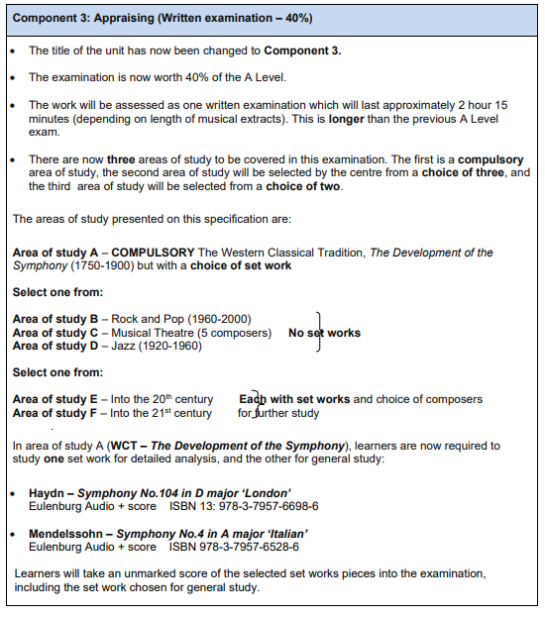

Component 3 - Appraising
We study AoS D
We study AoS E
These are your
set works

Slide 16
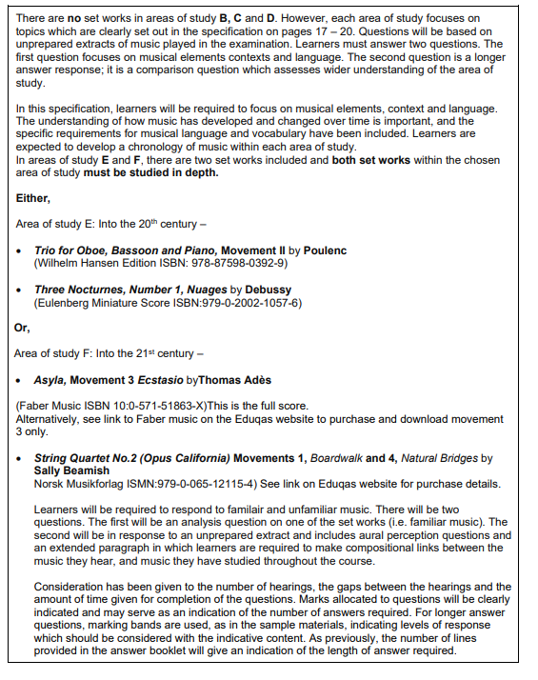
Component 3 - Appraising
These are your
set works

Slide 17
Component 3
A choice of one area of study from:
Area of study E: Into the Twentieth Century including two set works:
Trio for Oboe, Bassoon and Piano, Movement II: Poulenc Three Nocturnes, Number 1, Nuages: Debussy
Area of study F: Into the Twenty-first Century including two set works:
Asyla, Movement 3, Ecstasio: Thomas Adès
String Quartet No. 2 (Opus California) Movements 1 (Boardwalk) and 4 (Natural
Bridges): Sally Beamish
Questions:
  Set work analysis with a score
  Extended responses on wider context
  Unprepared extracts of music with and without a score
  Comparison questions
This component includes a listening examination.

Slide 18
TASKS
Component 1 - Prepare one solo piece for performance. It must last approximately 2 minutes and you will need to have a copy of the score for me to consult. Your piece should be grade 5/6 standard, minimum. Use slide 7 to help.
Component 2 – learn the terms shown on slide 10 (structure, devices/ development and tonality/ harmony)
Component 2 – work through the composing tasks A, B and C. I would like to see your ideas when you start in September.
Component 3 - Listen to Haydn’s Symphony No. 100 in G major and to Schubert’s Symphony No. 5 in B flat major. These are your set AoS A set works. Write a page about each symphony ensuring that you include details about the composer and the background to each composition.

Slide 19
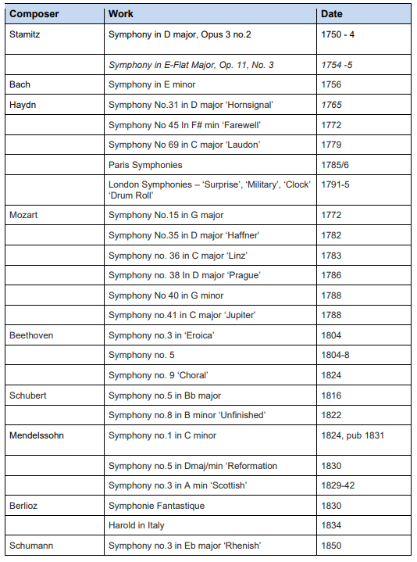
TASKS
5) Pick 2 symphonies
listed on this slide and the
next and find out:
When it was written
Instrumentation
Structure
Keys
Other key features
Write this down.

Slide 20
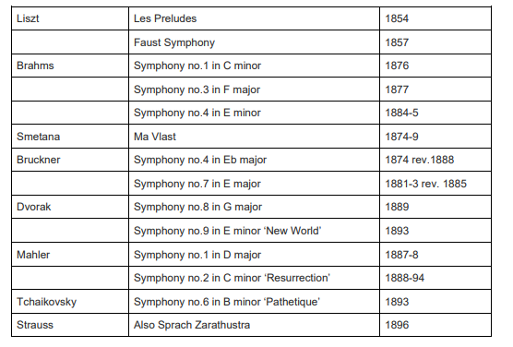
TASKS

Slide 21
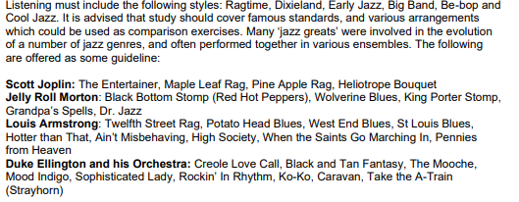
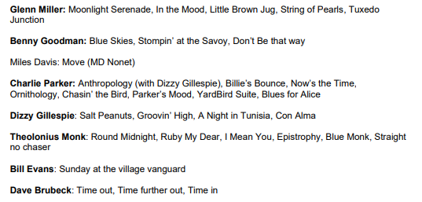
TASKS
6) Find out the key features
of Ragtime, Dixieland,
Early Jazz, Big Band,
Be-bop and Cool Jazz
Listen to a selection of the
Compositions/ albums
listed on this slide

Slide 22
TASKS
7) Brush up on your treble clef or bass clef reading if needed.

